Slide 1

Prince House Company
Address : Abdul Mogheeth – Al Harbi- Umm Al Hammam West – Riyadh
PO# 12328, 2nd Floor

Slide 2
History Of Prince House Company
Our Company Created and registered in 4 September 1979 for contracting in many fields under registration number 1010024787 all branches were lies under Civil Works and now we are doing expansions in medical fields.
Our investment in Medical field based on Customer satisfactions and speed service which reflect on our name and our image in the market.
Our Staff (Sales & Service) are the most expert in Ophthalmology devices .

Slide 3
Head & Neck Team
We have expert Engineers in Ophthalmology and ENT teamwork
Our teamwork has long experience in marketing and servicing most of Ophthalmology devices and ready for doing Service contracts with all hospitals and clinics in all kingdom cities.
Shortest duration for spare parts delivery and repair.
Shortest duration for response to Customers.

Slide 4
View & Plans
We are working on collect the best portfolio to our customers.
We are doing Service contract for ophthalmology devices.
Repair visits upon customer requests inside Saudi Arabia .
We are doing most of civil works for hospitals and clinics.
We offer Rent ophthalmology devices to small clinics.
Deliver new and Refurbished ophthalmology devices.
Exchange Customers’ old device with a new one.
Support from service team during the warranty period.

Slide 5

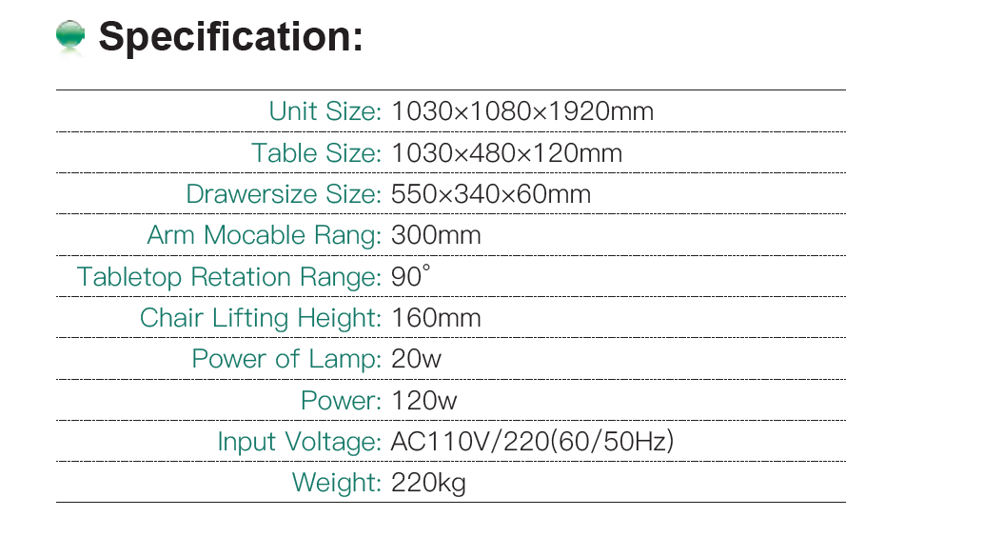
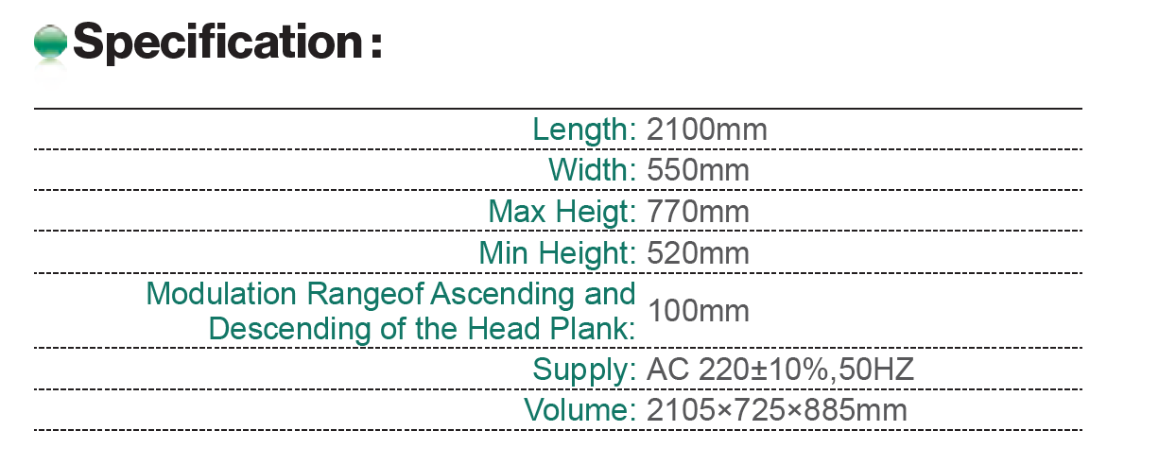

Slide 6

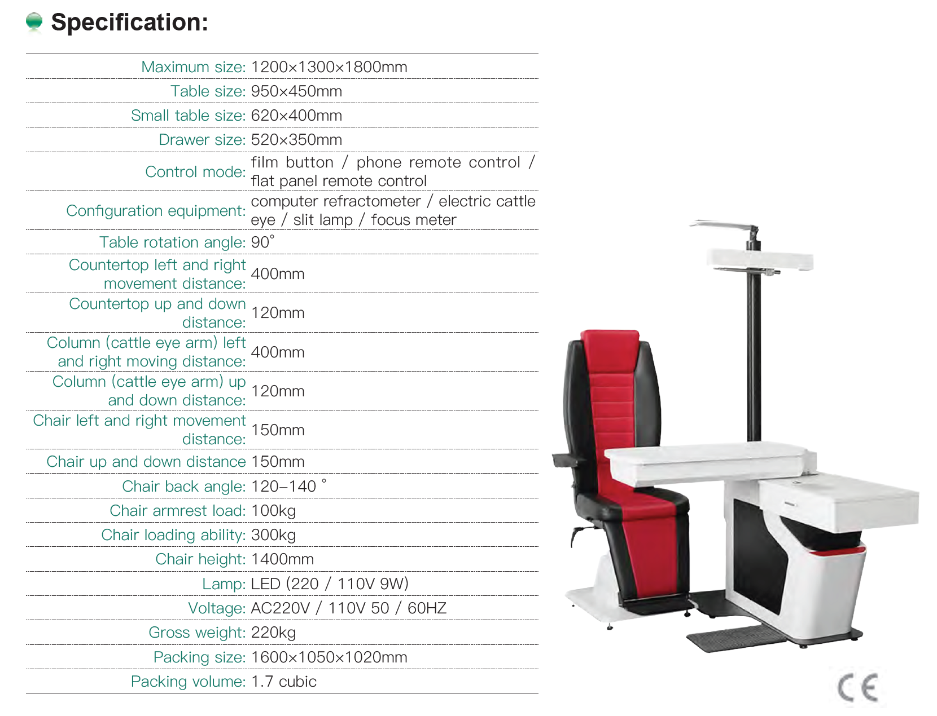

Slide 7
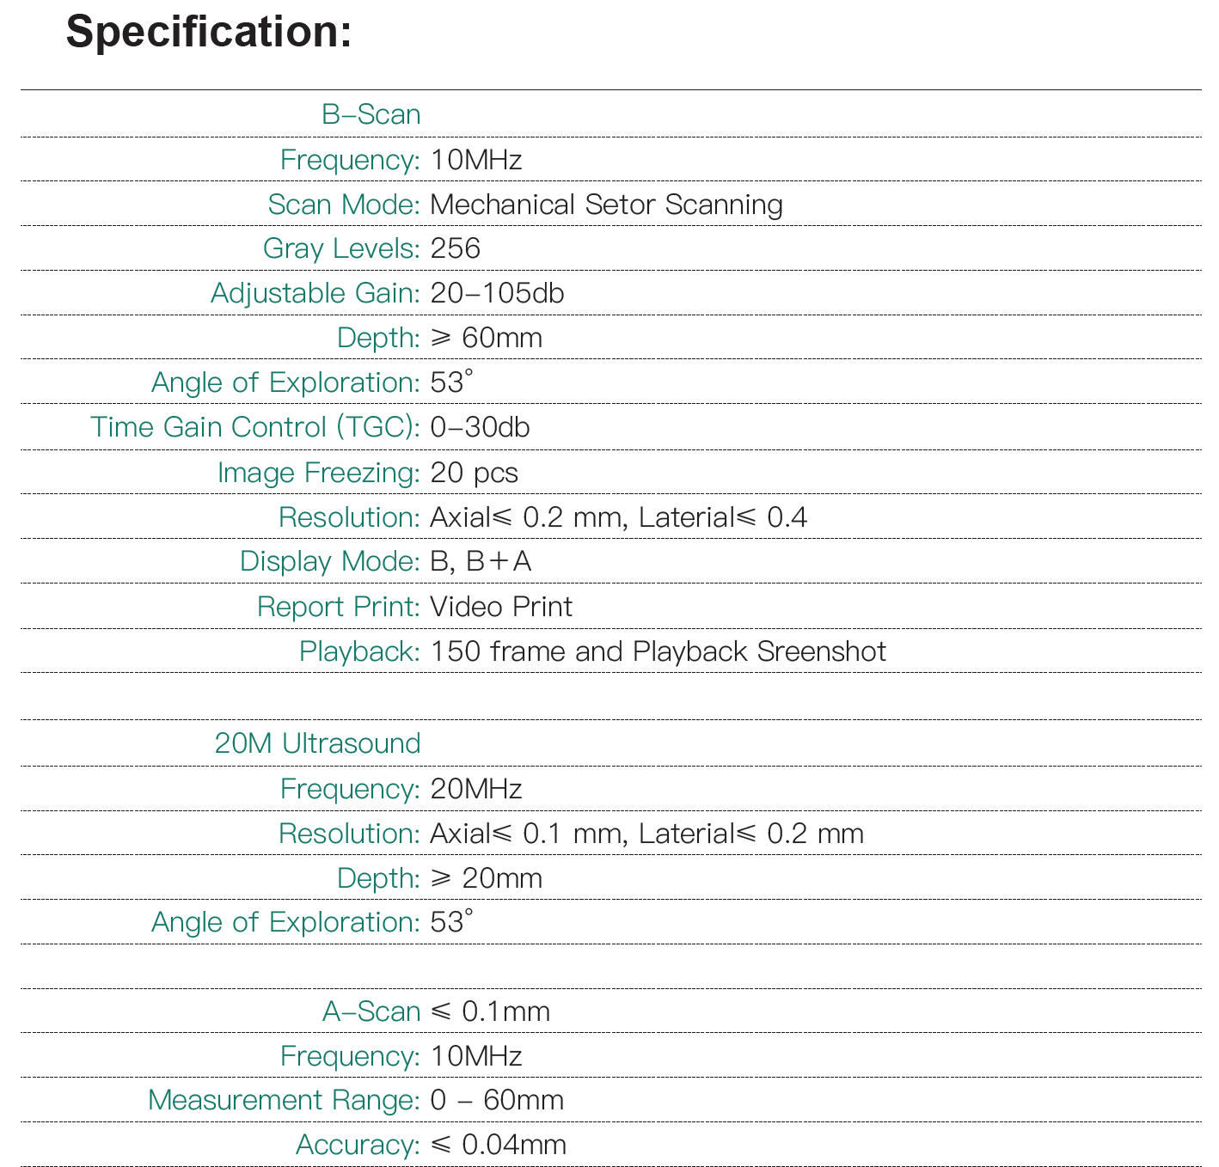
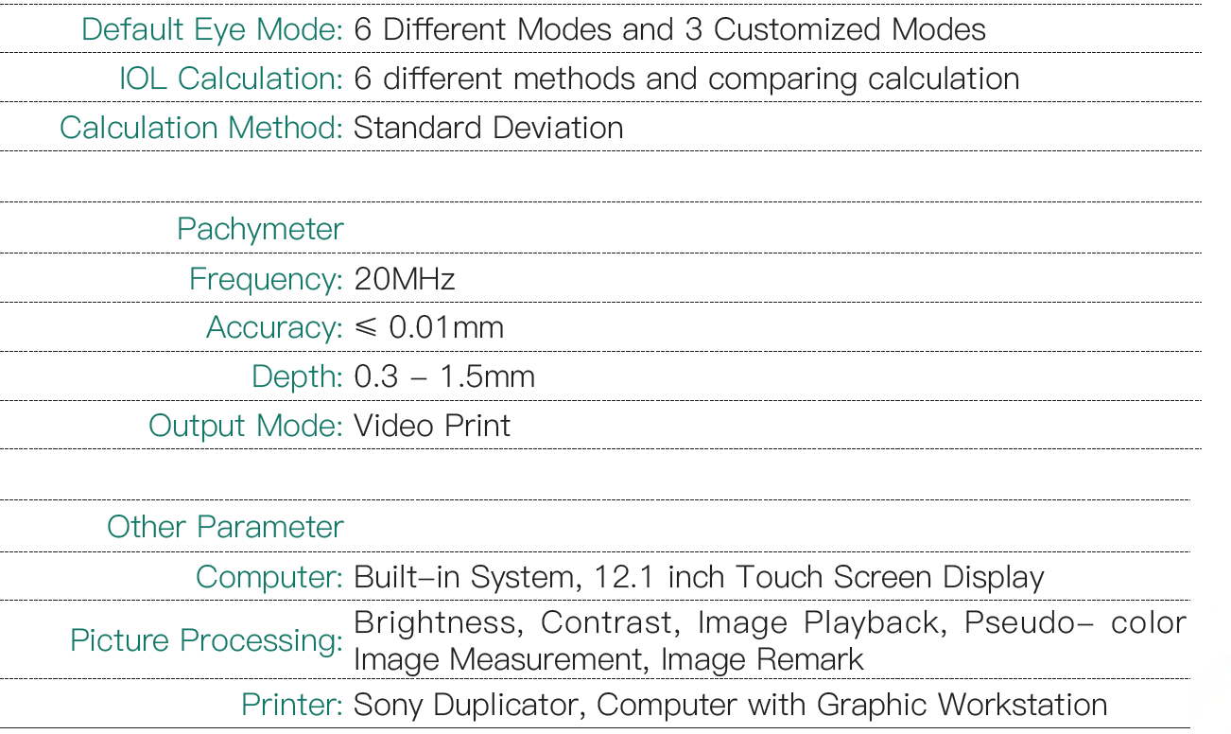

Slide 8

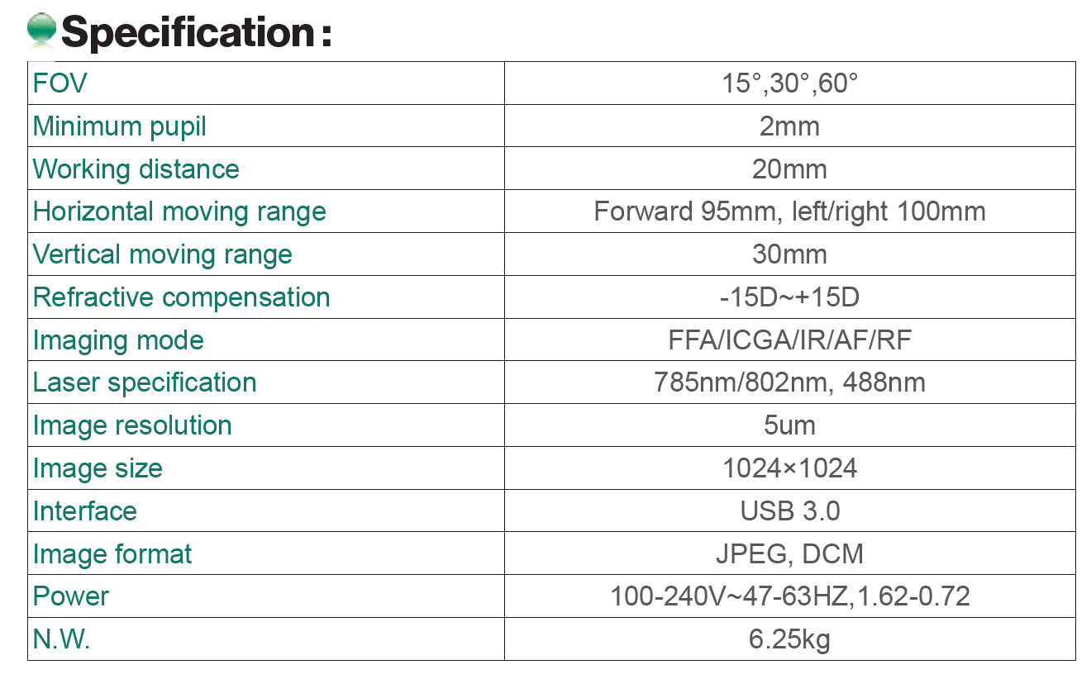
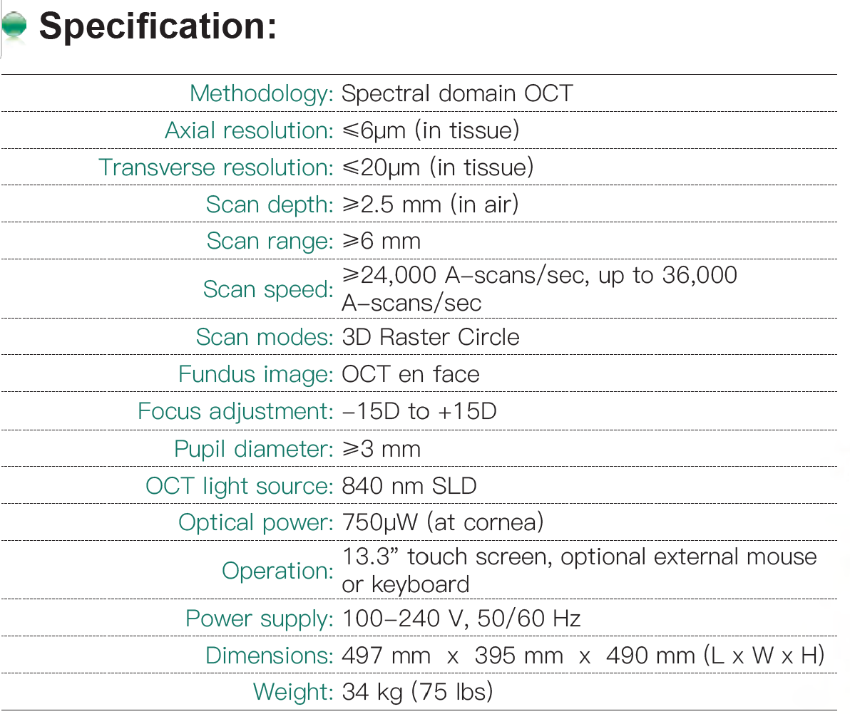

Slide 9
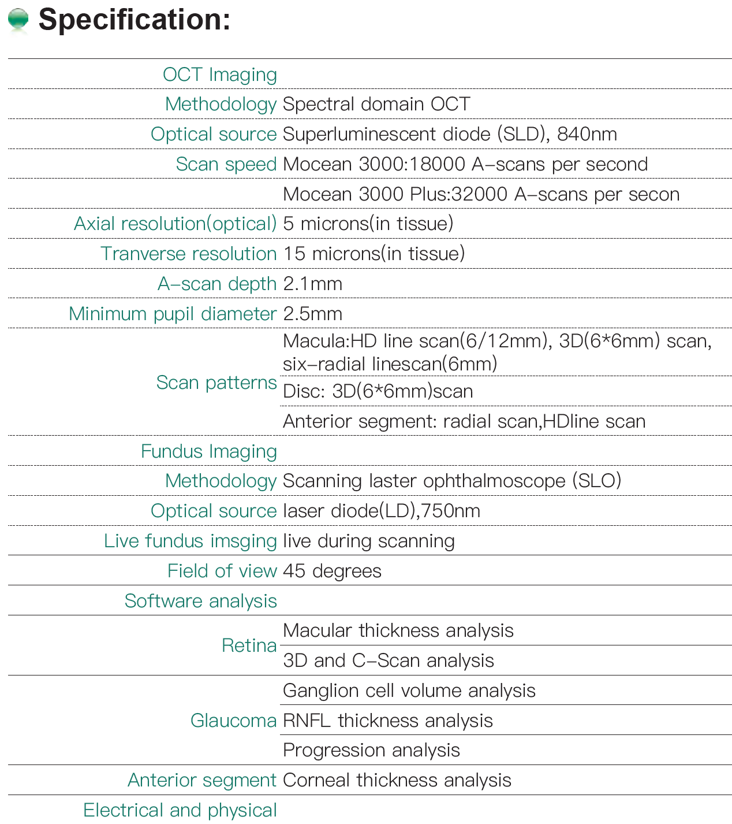
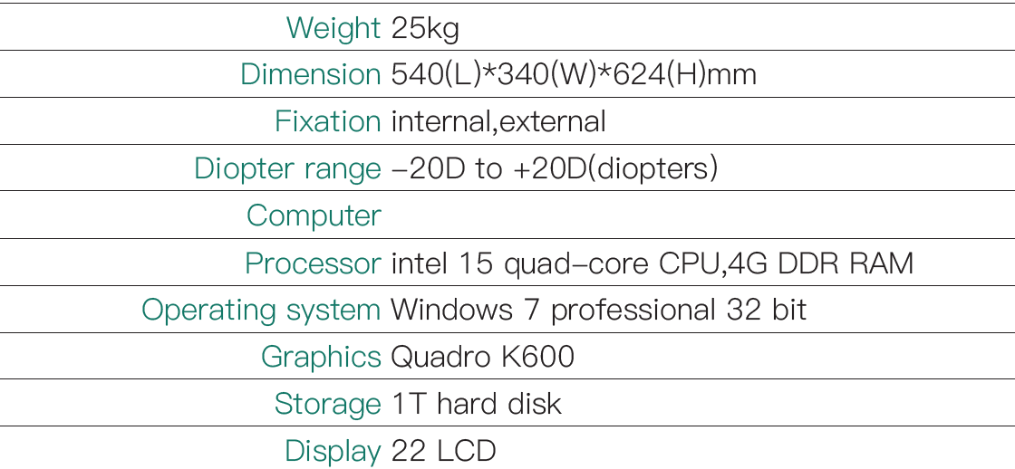

Slide 10
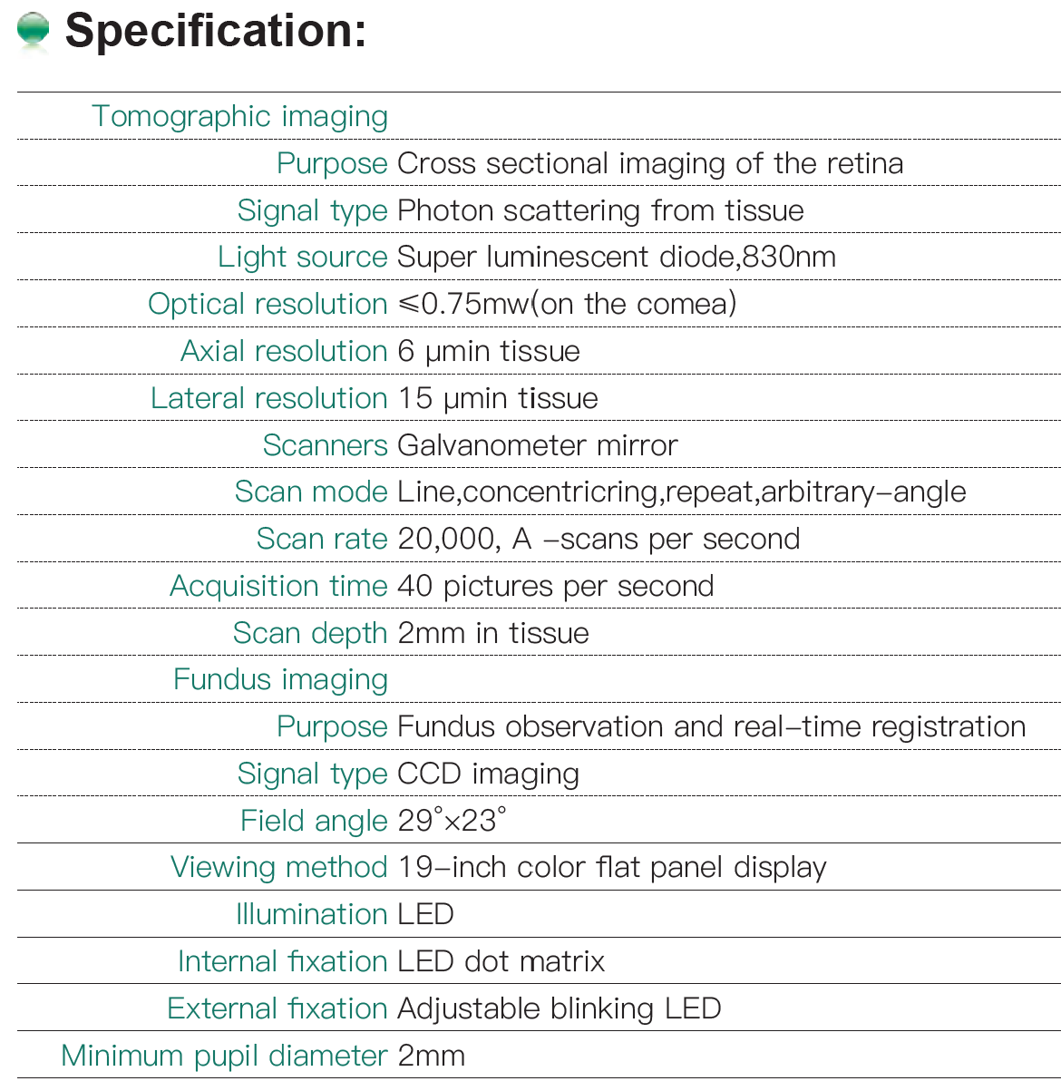
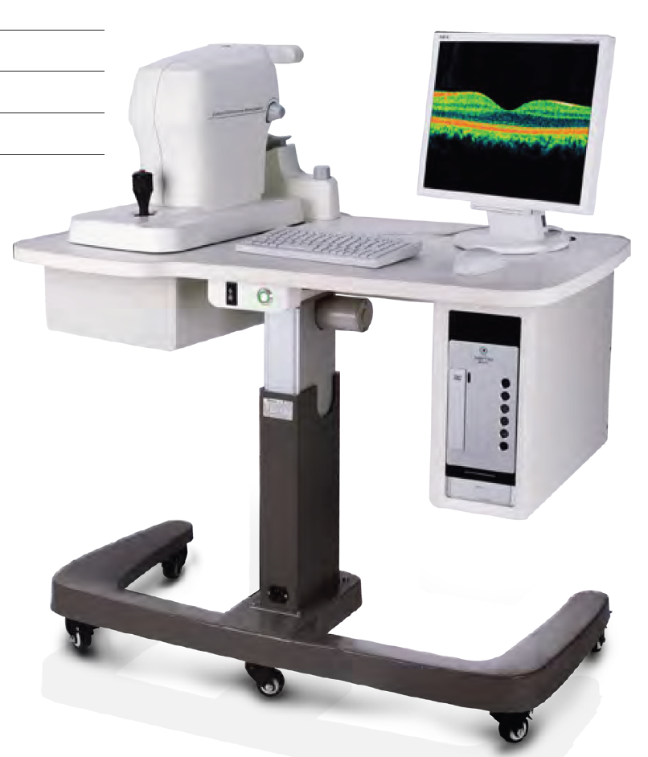

Slide 11
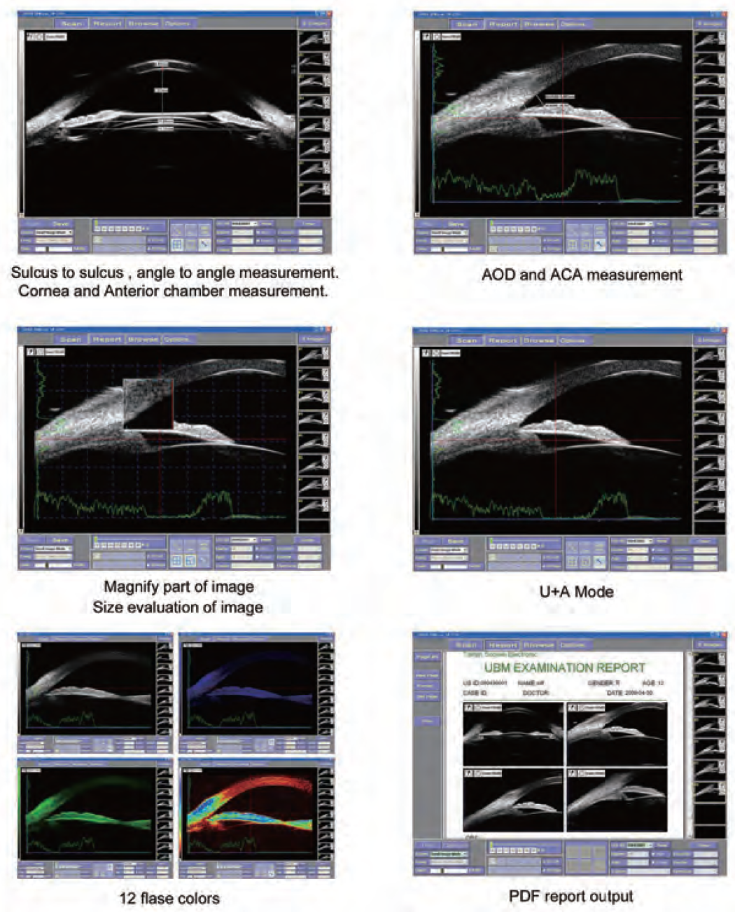
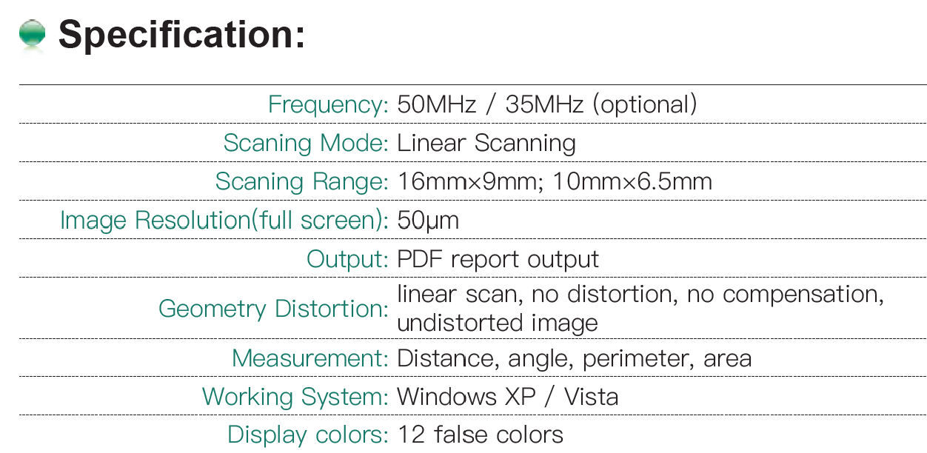

Slide 12

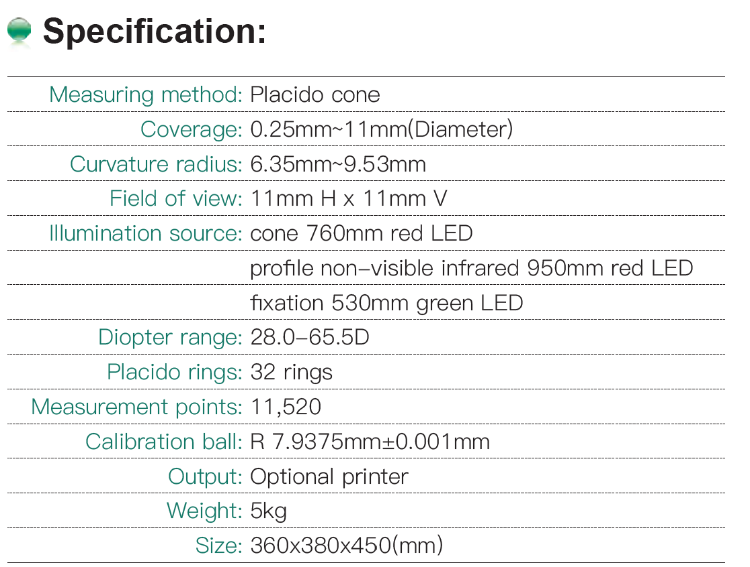
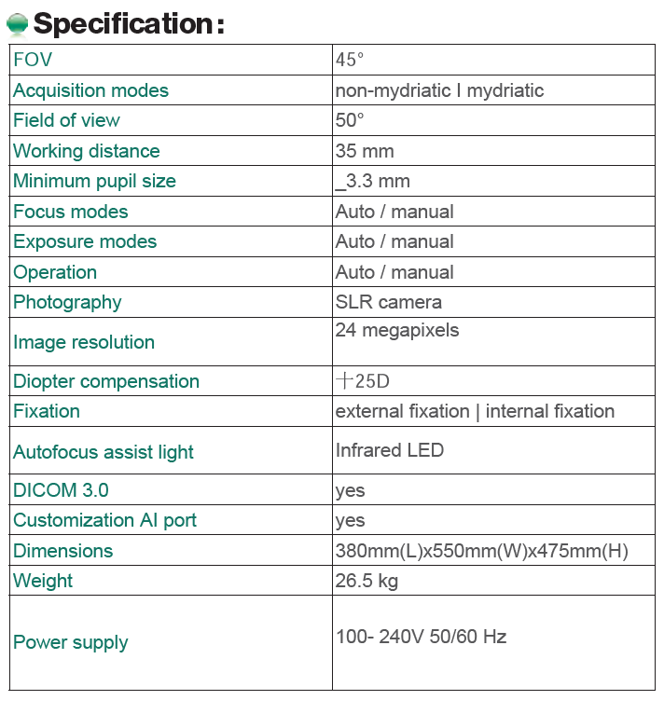
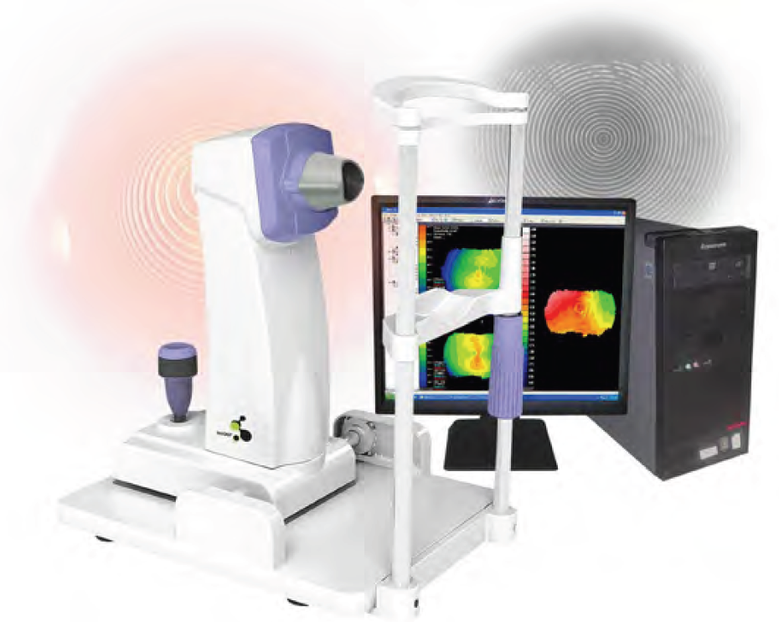
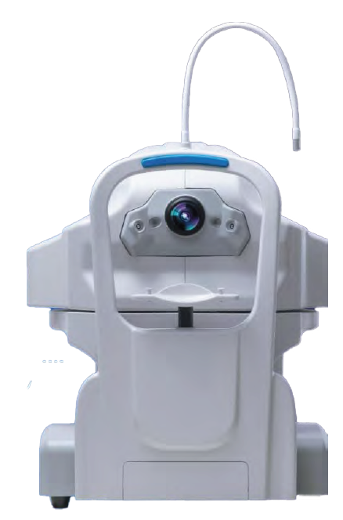

Slide 13
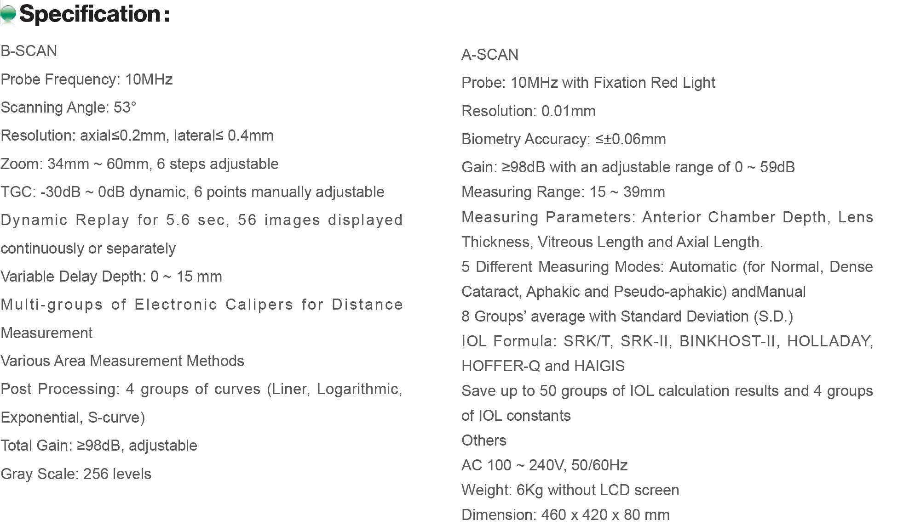

Slide 14
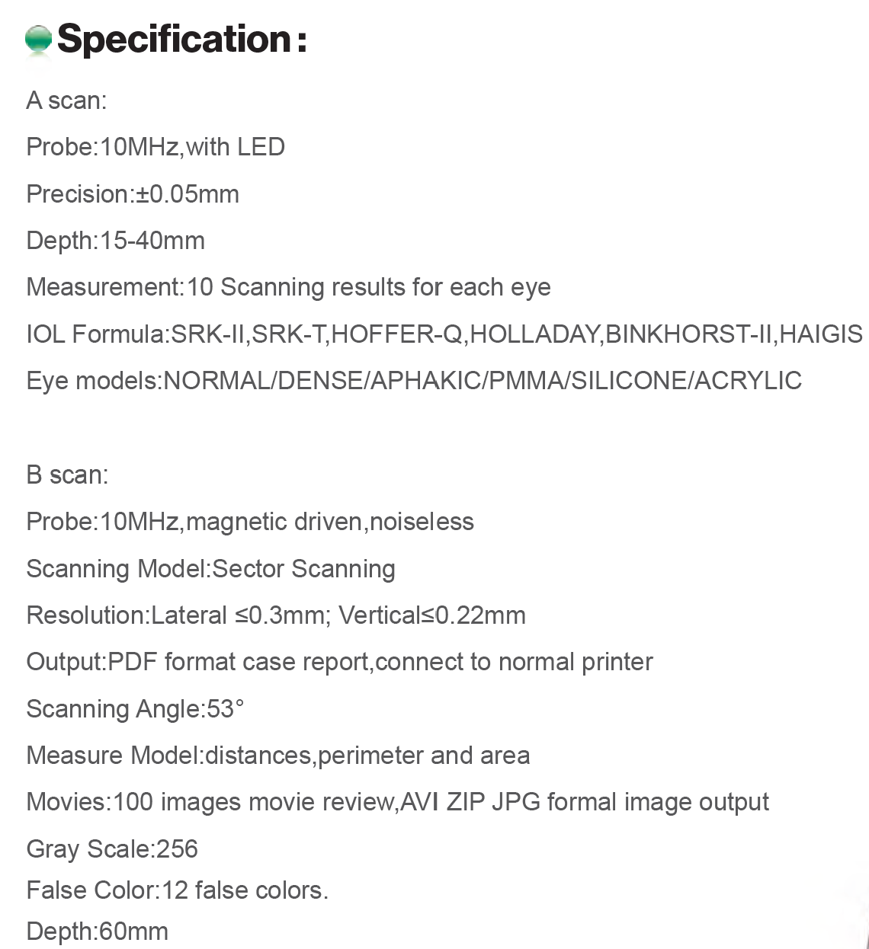
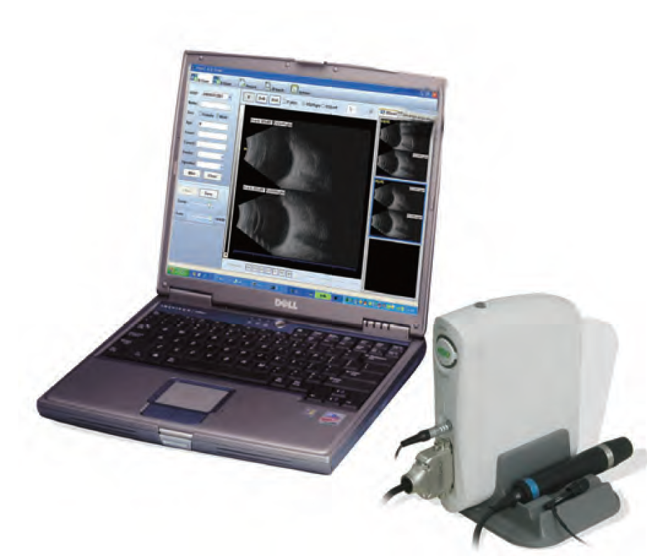

Slide 15
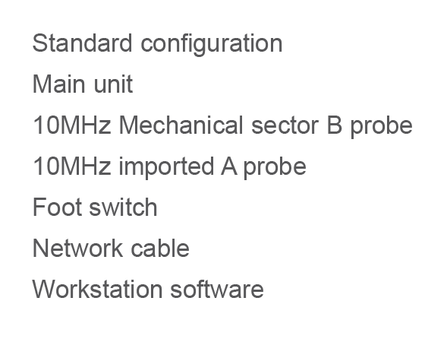
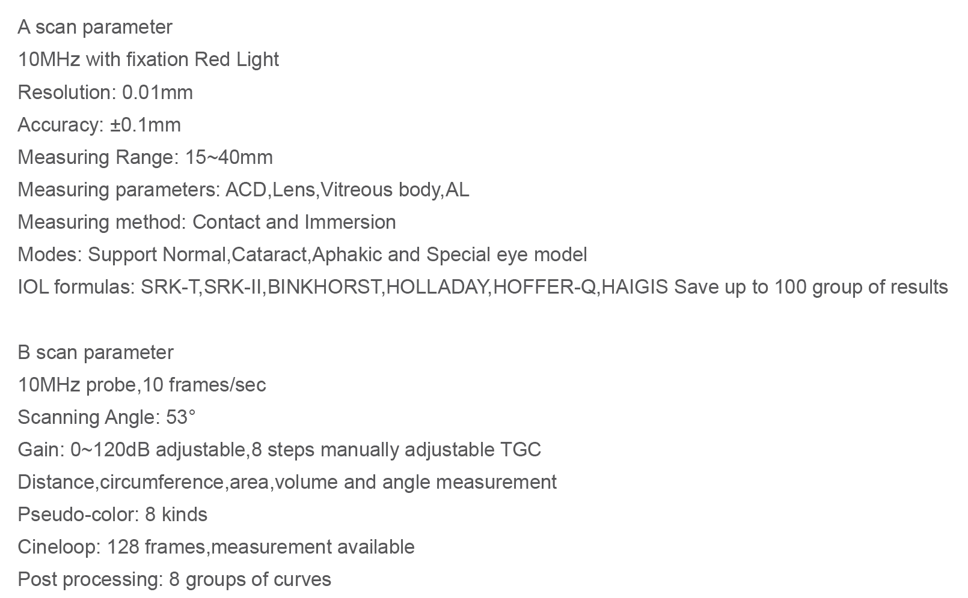
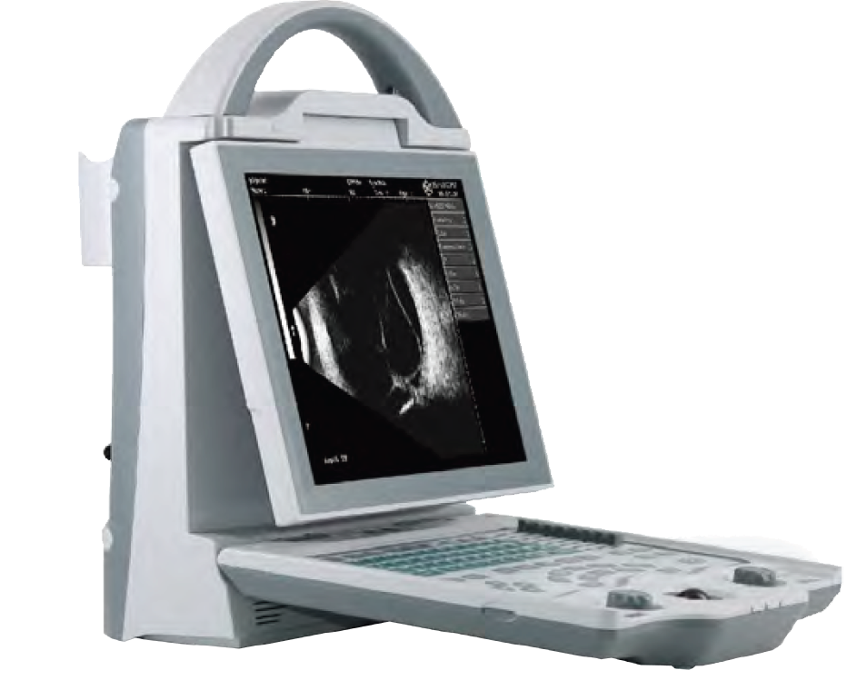

Slide 16
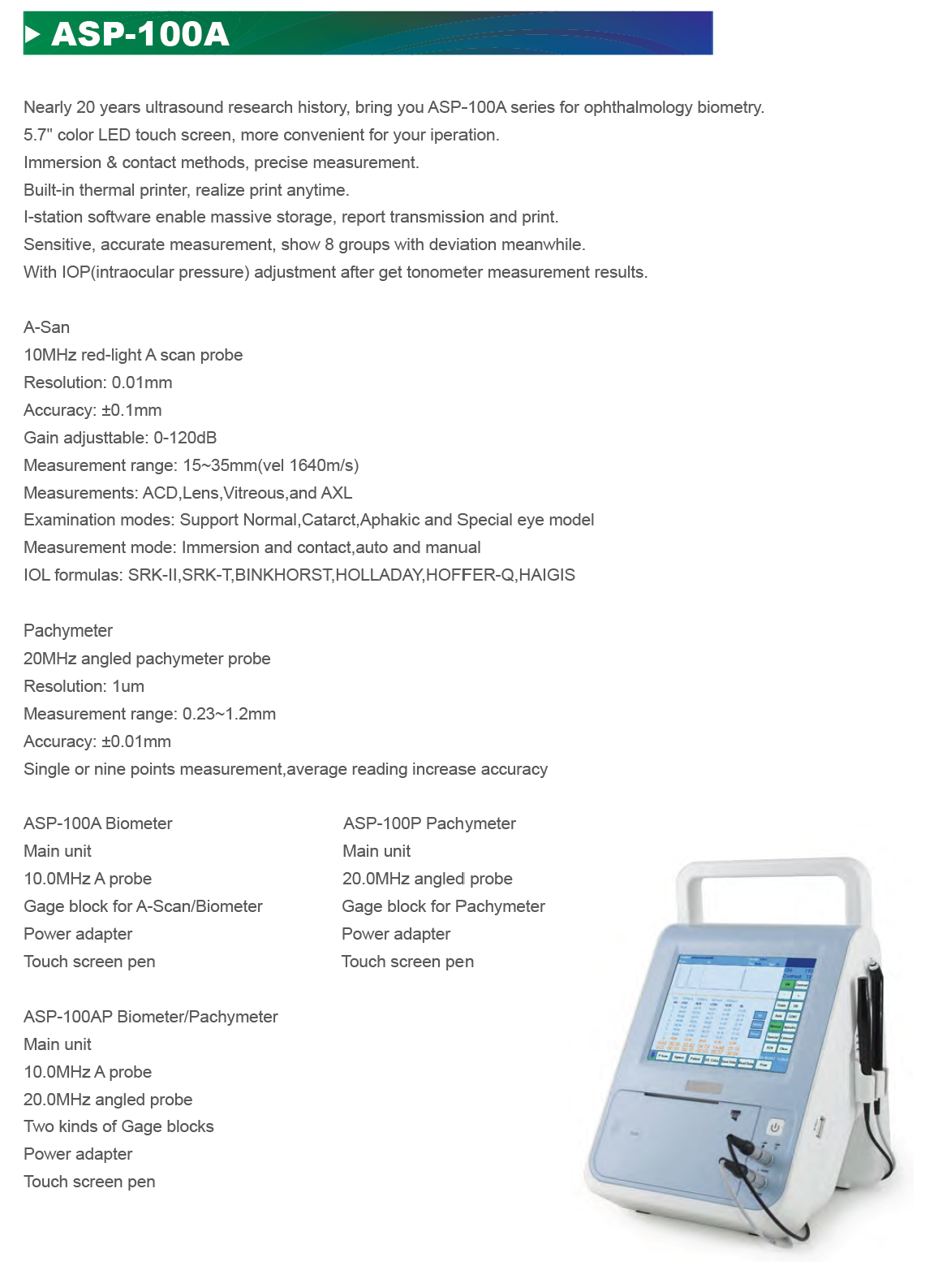
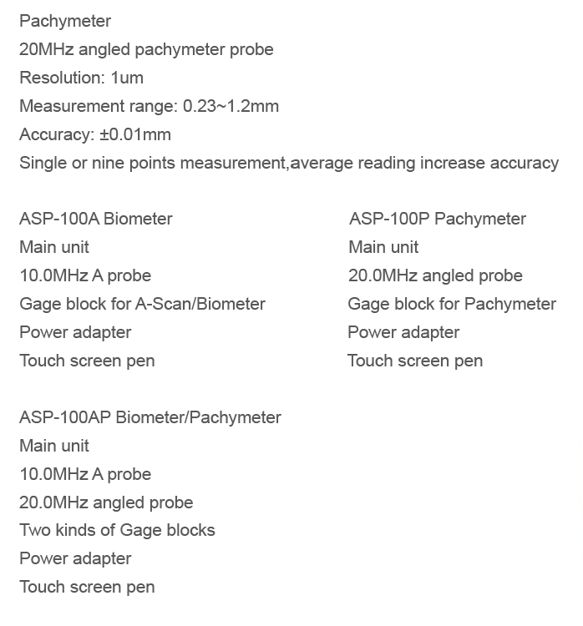

Slide 17
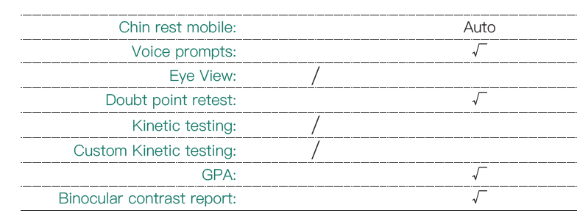
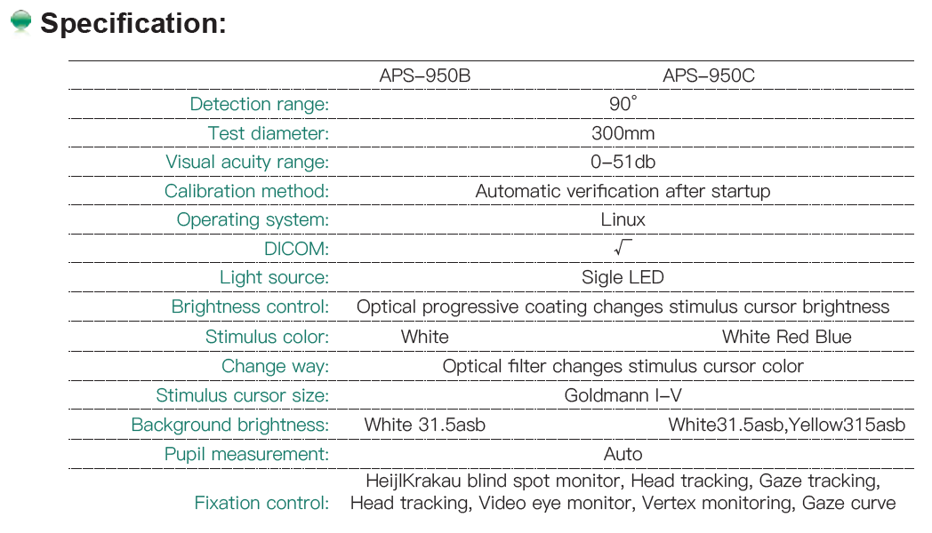
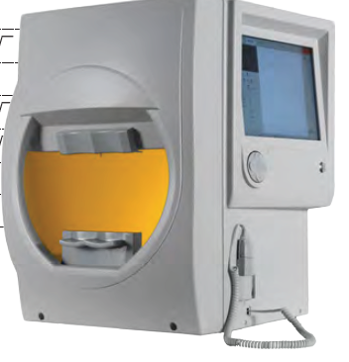

Slide 18

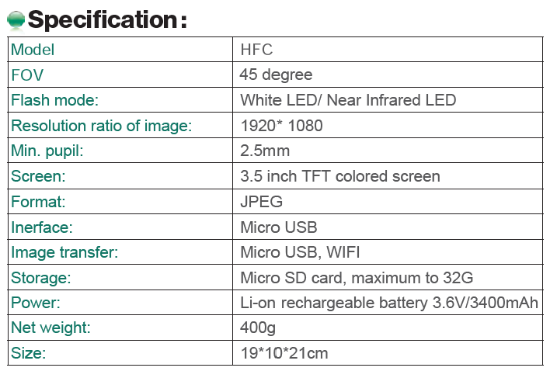
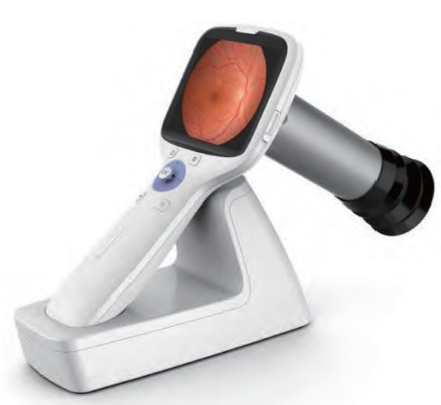

Slide 19
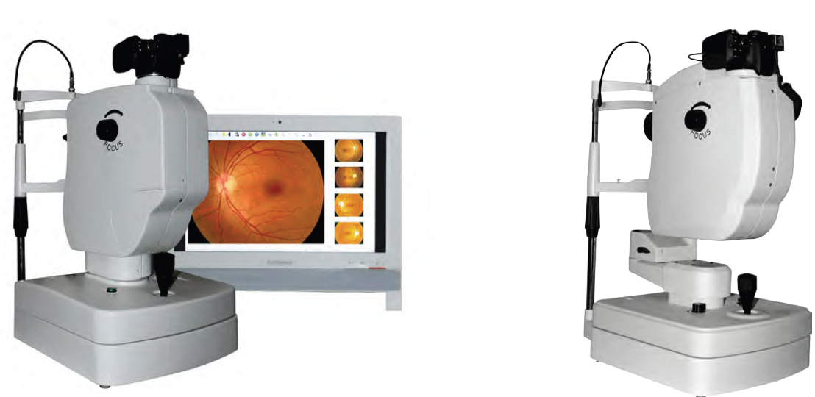
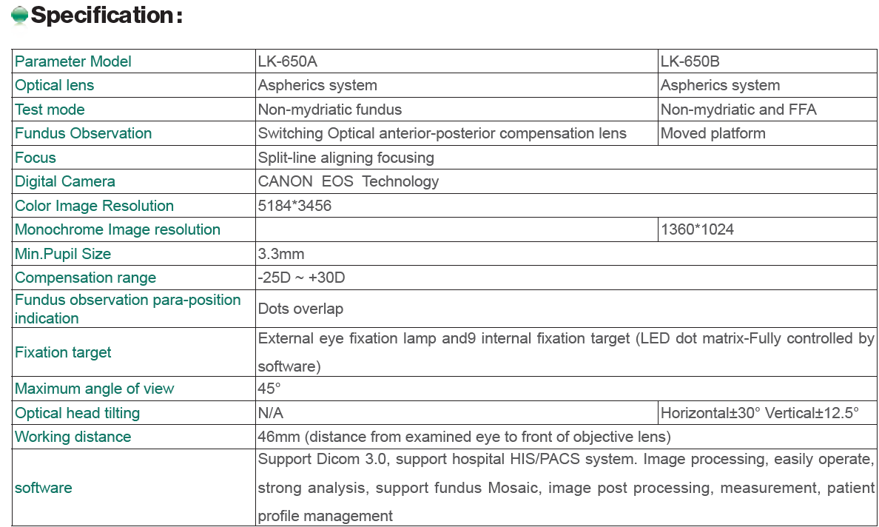

Slide 20
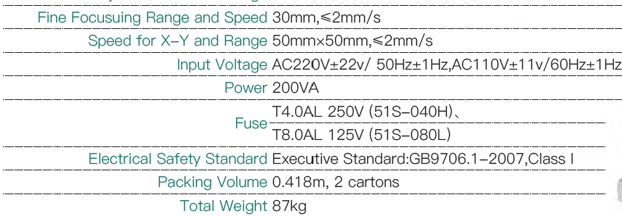
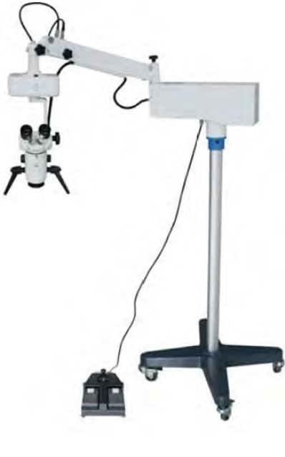

Slide 21
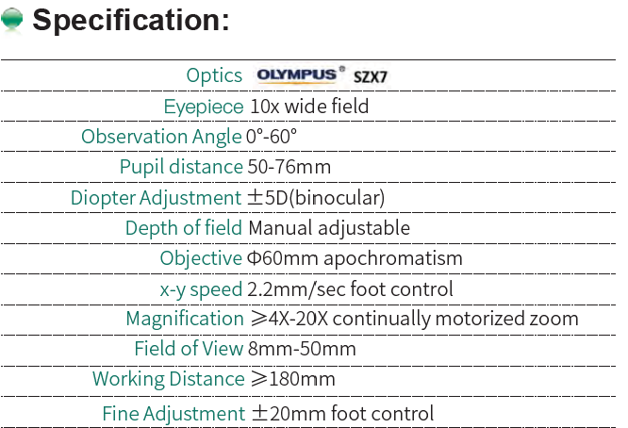
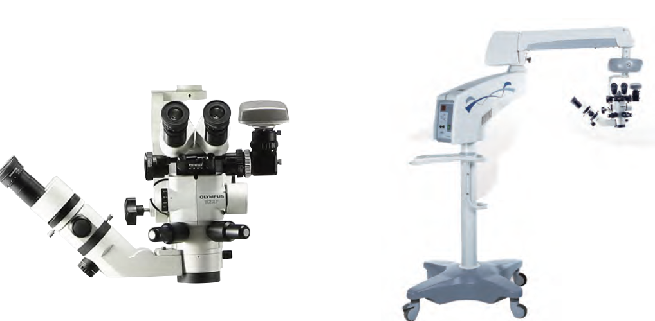
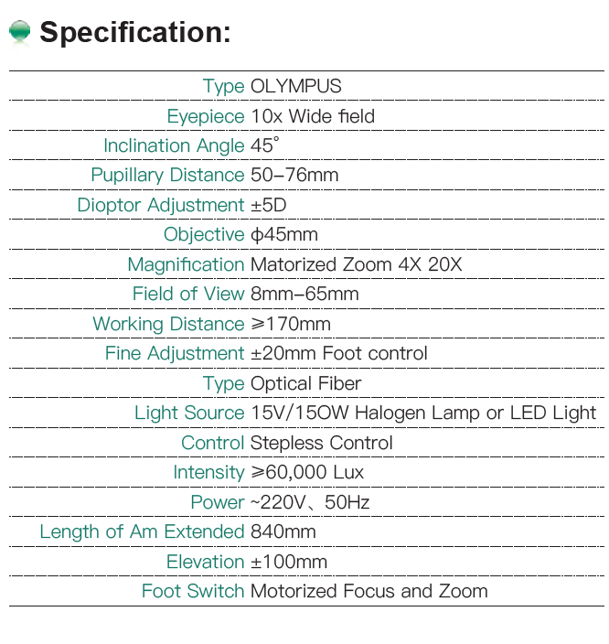
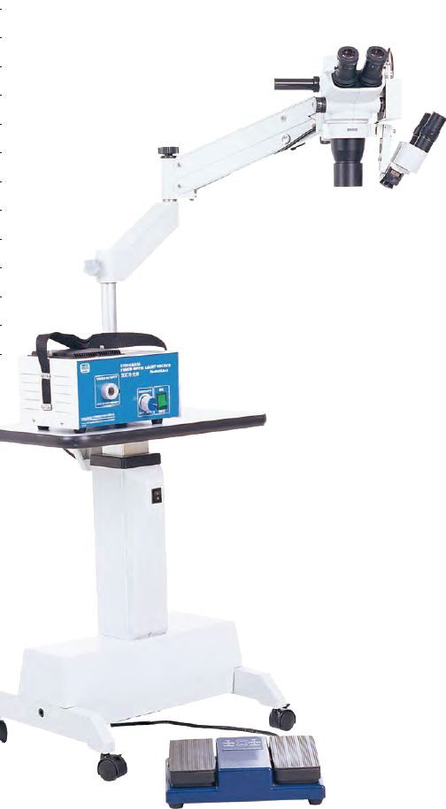

Slide 22
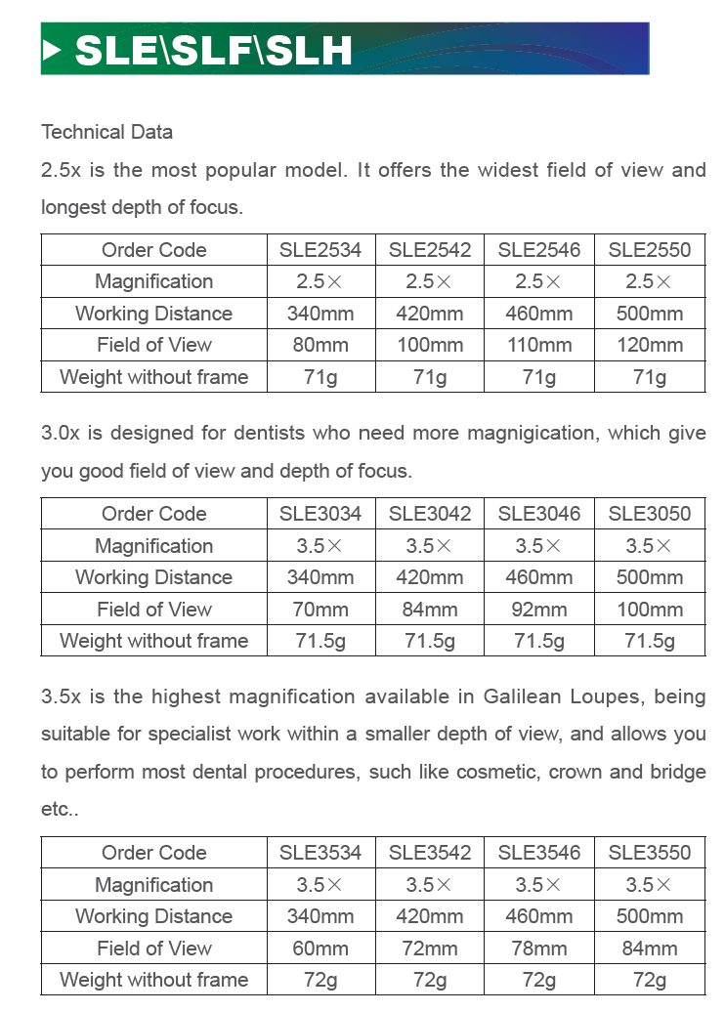
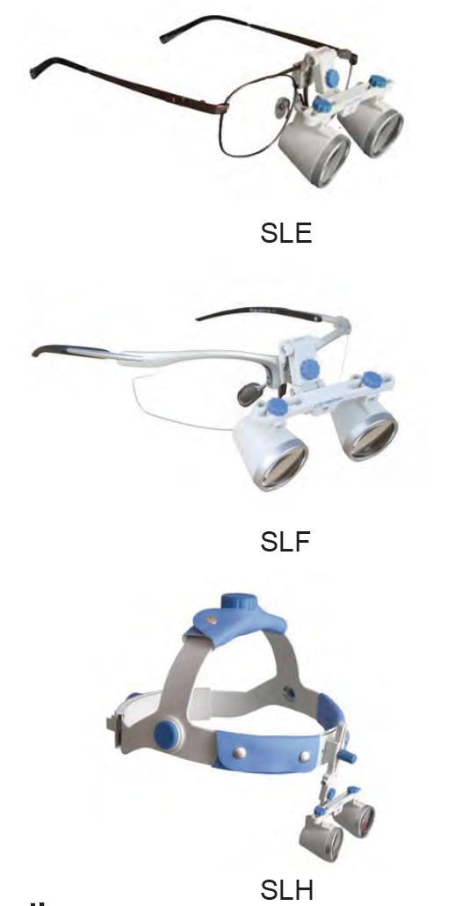

Slide 23

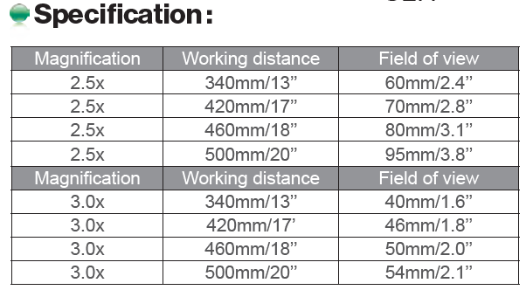
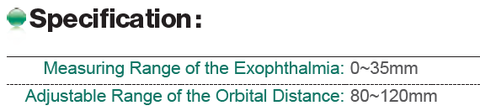
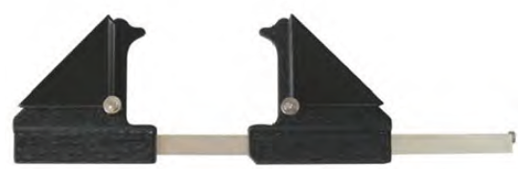
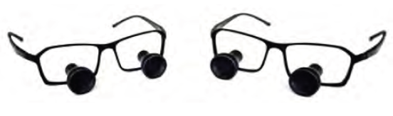

Slide 24
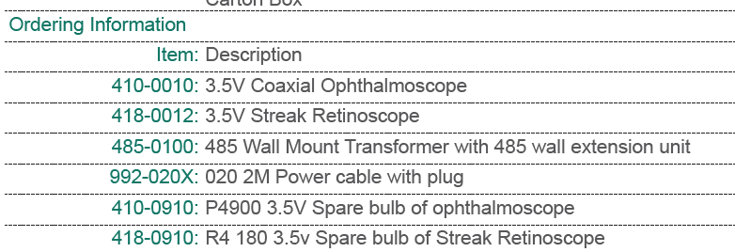
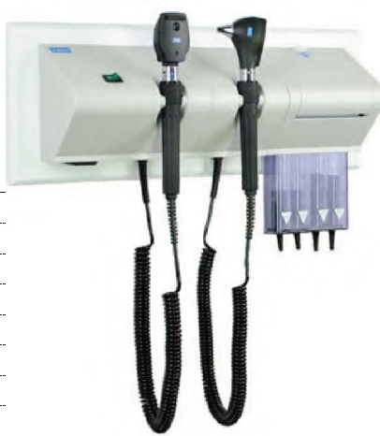
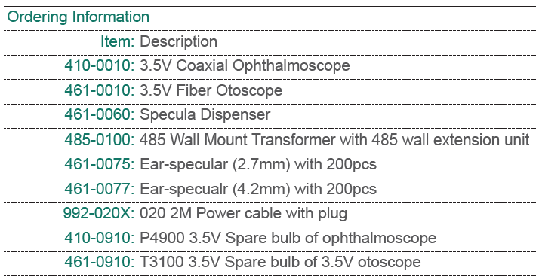
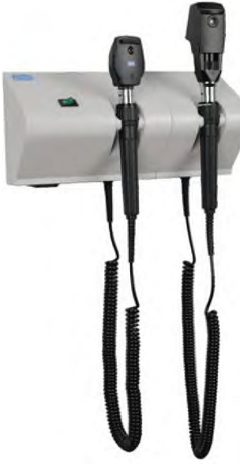

Slide 25
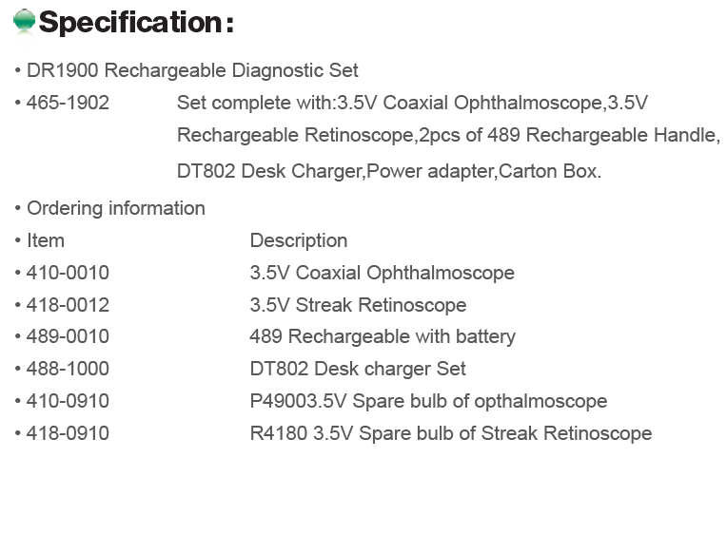
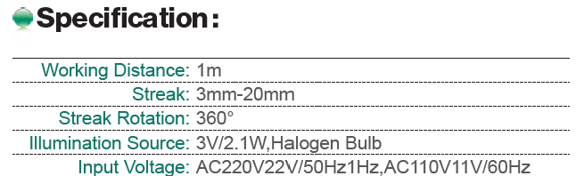


Slide 26





Slide 27




Slide 28





Slide 29





Slide 30



Slide 31





Slide 32







Slide 33





Slide 34






Slide 35





Slide 36





Slide 37









Slide 38






Slide 39



Slide 40




Slide 41




Slide 42





Slide 43





Slide 44




Slide 45



Slide 46






Slide 47


Slide 48



Slide 49



Slide 50




Slide 51




Slide 52


AL-360A
AL-360

Slide 53




Slide 54



Slide 55



Slide 56



Slide 57
Contacts
Sales Manager
Mr./ Mostafa Ezzat
Phone: +966538991723 Email: moustafa.ezzat@princehouse1.com
Sales Department
Mr./Hossam Jalal
Phone: +966547171435 Email: Hossam.jalal@Princehouse1.com
Sales support
Eng ./ Sherweit Mahmoud
Phone :+966565744953 Email: Sherweit.fahim@Princehouse1.com
Service Department.
Eng./ Hatem Bekheet
phone: +966569463039 Email: Hatem.bekheet@Princehouse1.com

